Slide 1
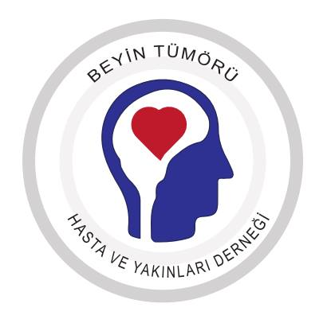
East meets West: the challenge of brain tumour treatment in Turkey
IBTA 2015, 2nd World Summit of Brain Tumour Patient Advocates
Nihat Karaoglu
Brain Tumour Patients and Caregivers’ Association, Turkey
Notes:
World is split with an invisible line which divides the globe East and West. This line passes through Turkey, a country influenced both by eastern and western cultures equally. In Turkey we observe the consequences of this in everyday life, including brain tumour treatments.

Slide 2
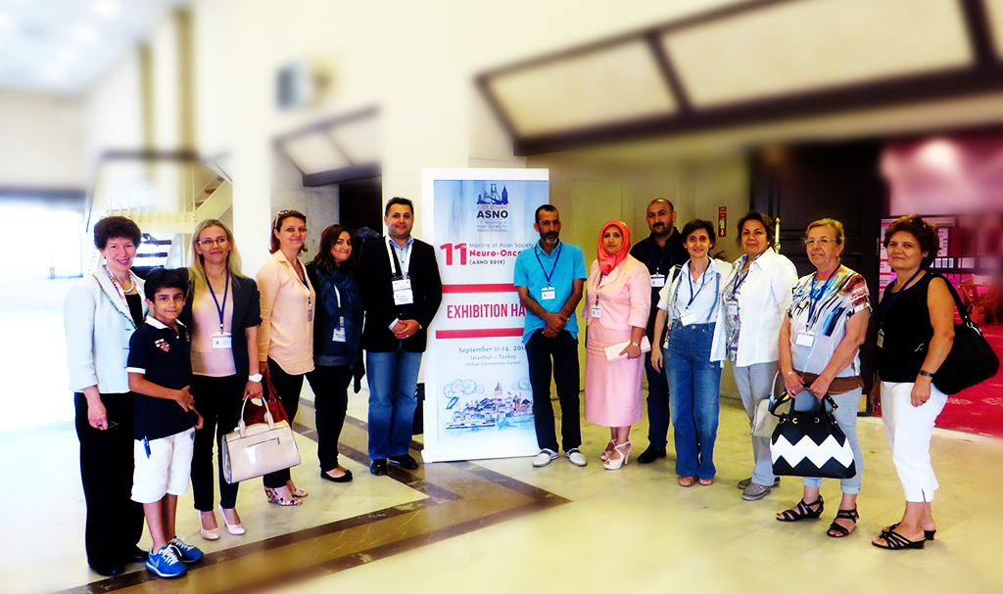
Brain Tumour Patient & Caregiver Assoc, Turkey
Notes:
This is us during a scientific conference, together with IBTA’s Kathy Oliver.

Slide 3
Brain Tumour Patient & Caregiver Assoc, Turkey
Initiative started in 2009
More than 1000 members
Active across the country
We;
Inform & Educate
Support
Advocacy
Notes:
Our initiative has started in 2009 with a handful of people and reached more than 1000 members today. We thank Kathy Oliver for her support since from the early days.
Our maın objective is to inform patients and caregivers about developments in treatments, educate them about the condition and treatment process. Support them when they need it, and defend their interest in different platforms.

Slide 4
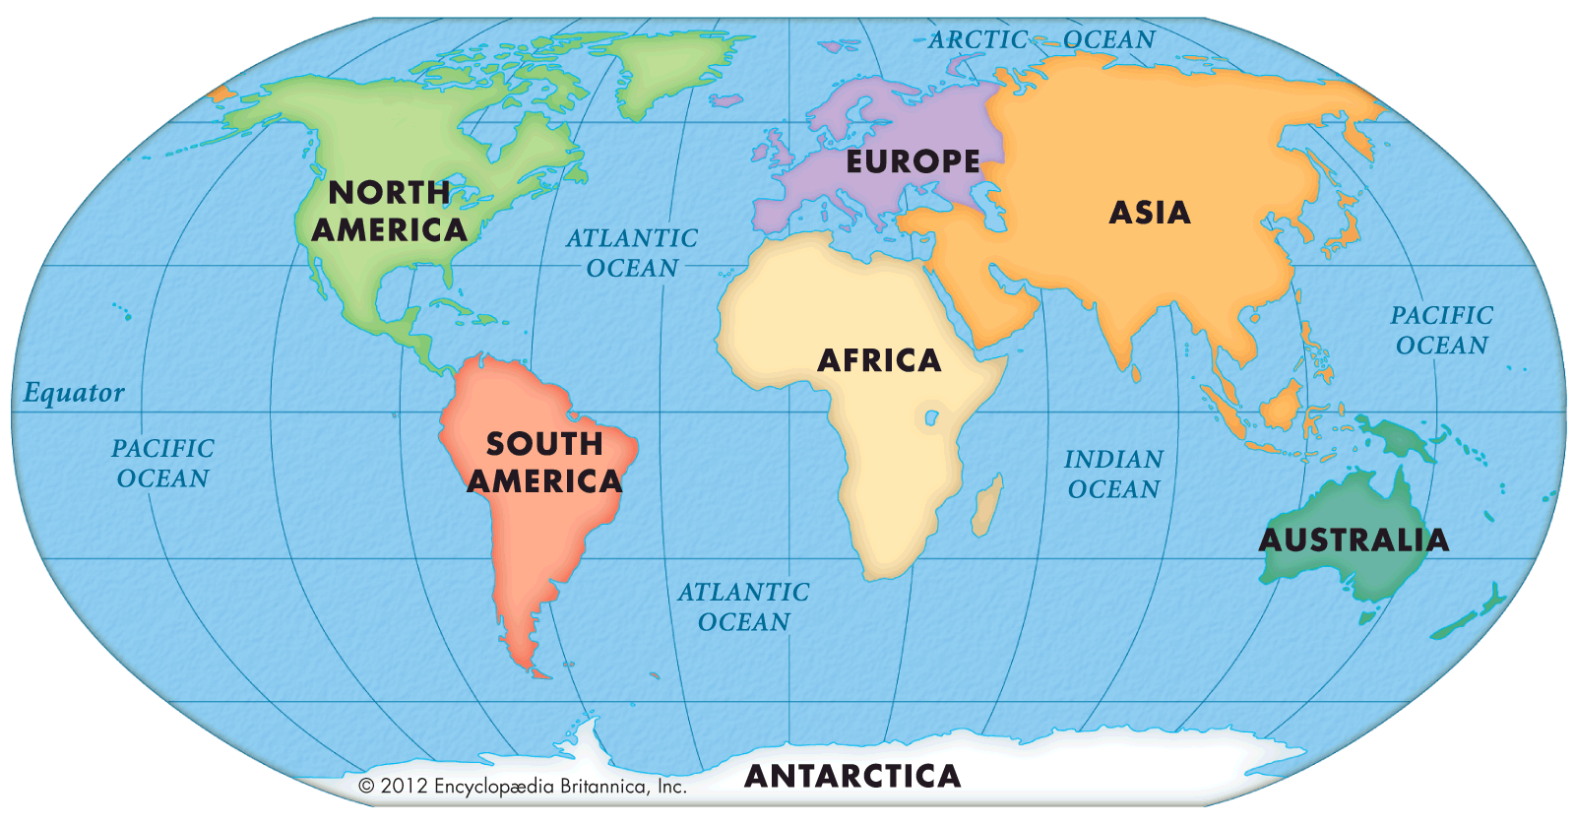
TURKEY
Notes:
Turkey is located at the intersection of 3 old continents. It has been influenced by cultures of the surrounding continents.

Slide 5
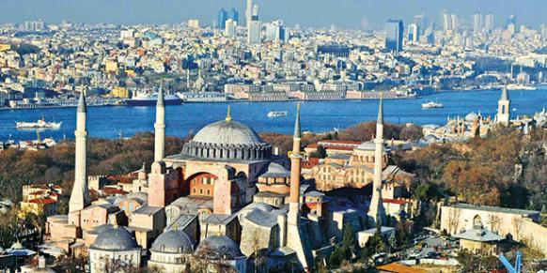
78 million people
TURKEY
Speak Turkish
Mostly Secular – Muslim
Christian – Jewish minority
Notes:
Turkey is on one side modern, European, on the other side, traditionalist and oriental. On one side you have sky scrapers of the modern city, on the other side you have a 1000 year old mosque which used to be a church before.

Slide 6
78 million people
TURKEY
Speak Turkish
Mostly Secular – Muslim
Christian – Jewish minority
Notes:
There are 78 million people living in Turkey, speak Turkish, mainly practicing and non practicing muslims as well as Christian and Jewish minorities, who generally leave in harmony.

Slide 7
78 million people
TURKEY
4000 newly diagnosed
15,000 PNS Patients
200,000 people affected
Notes:
Each year there are approximately 4000 new diagnosis of PNS. We estimate that there are around 15,000 patients with the condition and the disease affects about 200,000 people including families and friends.

Slide 8
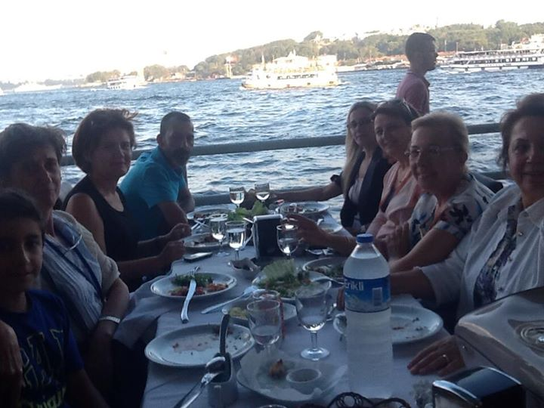
East Meets & West
We have the mix!
Notes:
So east meets West in Turkey. This is also reflected in our patient and caregiver community to varying degrees.

Slide 9
East Meets West: Cultural Dimensions*
Tool for describing national cultures
  Power distance
  Individualism vs Collectivism
  Masculinity vs Femininity
  Uncertainty avoidance
  Long-term orientation vs short-term orientation
  Indulgence vs Restraint
*Geert Hofstede, 1973-2010 research based on 120’000 people in 93 countries
Notes:
In order to analyze the cultural factors systematically, we will use the Cultural Dimensions framework of Geert Hofstede, a dutch socio psychologist who analyzed more than 120,000 people in 93 countries.

Slide 10
East Meets West: Power distance
Doctor is a supreme being vs a peer with knowledge to help
  Patient cannot express him/herself well
  Not many questions asked.
  Seeking 2nd opinion is a problem
  What if the doctor gets angry because his authority is questioned?
Remedies:
  Patient reps; Attend conferences, talk to docs, build credibility
  Inform patients; It is their life choice, they have the right!
  Inform docs; What they don’t know, they cannot control.
Notes:
First cultural measure we look at is called Power Distance. It is the inequality of power distribution between doctor and patient roles. It manifests itself as the doctor being the absolute authority and the patient a subordinate. On the other end of the spectrum we have the doctor being perceived as ‘a peer’ with knowledge to help.
In Turkey we have the former where the doctor is the absolute authority. The drawback is that patients cannot Express themselves during a session. They often leave with a lot of questions.
Seeking 2nd opinion is also a problem. What if the doctor gets agry when he finds about that, because he feels his authority is under question?And patients are not always wrong either.
One of the remedies for this problem is to have patient representatives. These representatives attend conferences, talk to doctors and build credibility, such that professionals regard representatives as ‘their partners’.
From the patient side, patients are informed that they have right to have a second opinion. It’s their life! They are the authority on their life. The doctors are also reminded about this right by the patient representatives.

Slide 11
East Meets West: Individualism/Collectivism
Close knit society – safety net
  Hospice care is seen as a disgrace– collective help
  Decisions are taken collectively burden is shared collectively. Patient has little say on the decisions
Remedies:
  Support & empower patients
  Talk to family
Notes:
Turkish society is a close knit society. The good thing about this is that there’s always a social safety net..
The problem is that, hospice care is seen generally as a disgrace to the family, although the patient may have a better quality of life.
The other aspect of collectivism is that, decisions are taken collectively and the burden is shared. The bad thing is that the patient often has little say on the decisions that impact their life.
The remedy for this is to remind the patient is that it is their life and empower them. Talking with the family as patient org, as ‘a neutral third party’ also helps.

Slide 12
East Meets West: Masculinity/Femininity
Doctors; Assertive, success oriented, risk taking vs modest, caring, safe players
Remedy
  Know each type, use the proper one when you need one
Notes:
Masculinity/Femininty manifests itself in doctor role. In one group we can have assertive, success oriented, risk taking individuals, in the other group we can have modest, caring, safe players.
We have the both types in our society. What we advise is to know each type and use the proper type when needed. Patients may start with a modest and caring doctor, then switch to another type if their condition requires one.

Slide 13
East Meets West: Uncertainty avoidance
  Rigid laws & roles, low activism, tolerance to change – stability vs reformism
  Hard to change the status quo.
  People are not interested in change; They are interested in finding their ways around
  Remedies;
    Informal groups & meetings; use of social media
    Making use of built up social “know how”
    Leader oriented and hierarchy, chain of authority and command
Notes:
In societies which avoid uncertainty, there are rigid laws and roles. There is tolerance to change and activism is low. People choose stability over reforms.
It is hard to change the status quo in such societies. People are not interest in change, they are interested in finding their ways around.
Low activism is always a big problem in a patient organisation. People refrain from attending formal meetings or protests. Don’t rock the boat is the general motto.
One way to overcome is to use social media, informal groups and meetings. People feel much comfortable to meet with their peers without any formal label.
Since changing the status quo is difficult and long term, it is important to use the social ‘know how’ to get things done. There’s always a way to access a certain treatment.
Within the patient organization, a flat, consensus based structure may not work. A leader oriented structure with chain of authority and command might be more suitable.

Slide 14
East Meets West: Long term & Short term
Tradition is sacred, universal guideline for good & evil , success & failure is luck-destiny
Conspiracy theories; pharma is evil, taking money is evil
Scepticism towards modern medicine; cancer is a modern disease, ancestors didn’t have it, medicine cannot cure, cure is in the nature
Remedies:
  Mix them with enlightened peers, educate them
  Funding; create a self sufficient organization
  Regulate it ☺ - Training and certification programs for practitioners of “alternative treatments”
Notes:
In a short term oriented society tradition is sacred. There’s an universal guideline for good and evil. The success and failure is due to luck and destiny rather than hard work or lack of effort. Science is not the only (best) source of knowledge, there’re other ways to obtain knowledge such as tradition, revelation, intuition, experience.
In such societies, there’s scepticism towards modern medicine. It is believed that the cancer is a modern disease, and the ancestors didn’t have it, modern medicine cannot cure it. The cure might be in the nature. Therefore people often seek herbal treatments before or along with modern treatments.
People believe in conspiracy theories about big evil pharma. Therefore it is very hard for a patient organization to collaborate or get private funding without risking their credibility.
Remedies in short term oriented society could be to mix the patient and caregivers with ‘enlightened’ peers. Peers who are educated and whom they can trust as they are in the same boat.
For a patient organization alternative ways for funding might be sought. One solution is to create a self-sufficient organization which generate income to finance activities while benefiting the community. Such ideas might include a low-cost accommodation facility for patients which can generate income for the organization while serving the patient community.

Slide 15
East Meets West: Alternative Therapies
Safety
Accept
Monitor
Encourage
Monitor
Discourage
Monitor
Warn
Monitor
Safe/Ineffective
Safe/Effective
Efficacy
Unsafe/Ineffective
Unsafe/Effective
Notes:
Regardless of their scientific basis alternative therapies stay always actual in the patient and caregiver community. Forbidding or banning such treatments is ineffective as people would continue to try these methods.
A better method would be to accept and regulate these treatments. One such step is taken recently by the Turkish government. A law has been passed to ‘license’ practitioners of certain methods such as ‘leeching’. This way these could be applied to patients more safely even if they are ineffective, but in the long term may change how the ‘alternative therapy’ market functions in patient’s benefit. (People would choose licensed medical professionals over unsafe practitioners)
We as a patient organisation use the guidelines laid down by Turkish Medical Oncology Assoc. This states that if an (alternative) treatment is safe and effective, its use is encouraged but the patient is monitored. If the treatment is effective but unsafe patient is warned and monitored. If the treatment is safe but ineffective it is accepted and the patient is monitored. If the treatment is both unsafe and ineffective it’s use is discouraged.

Slide 16
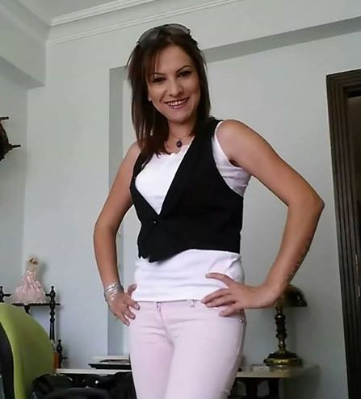
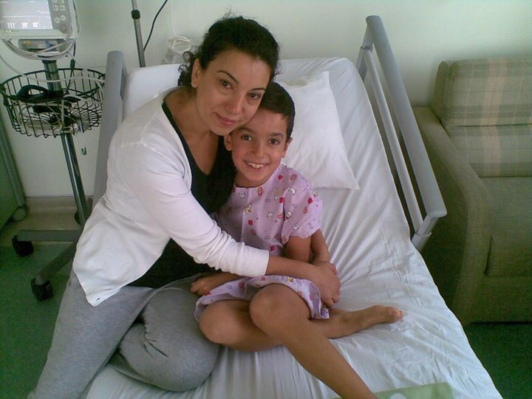
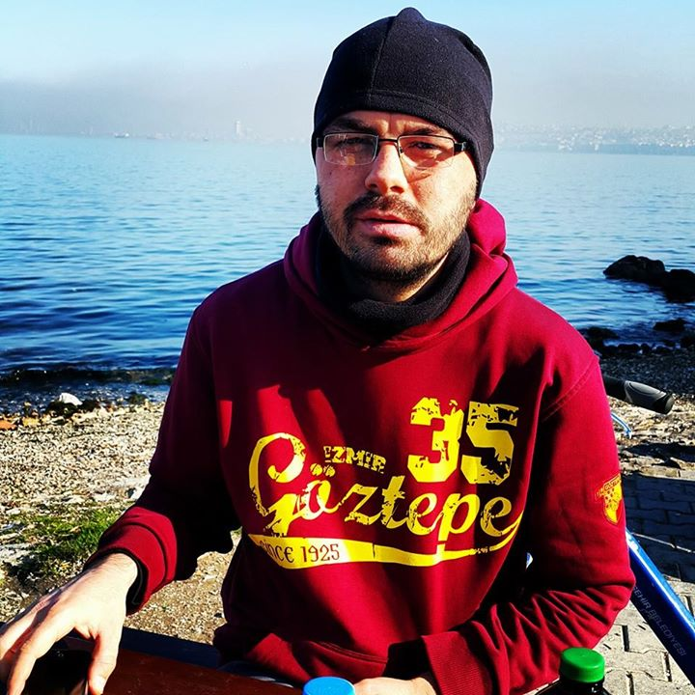
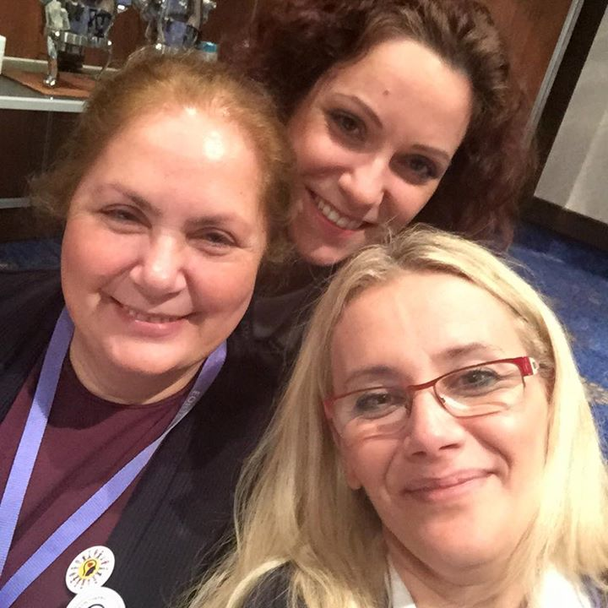
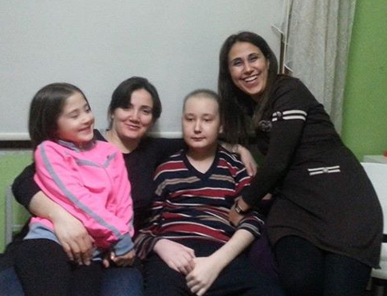
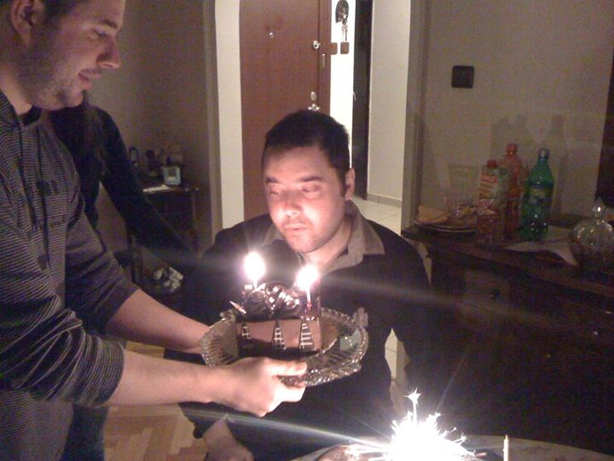
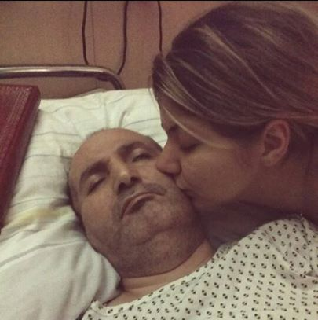
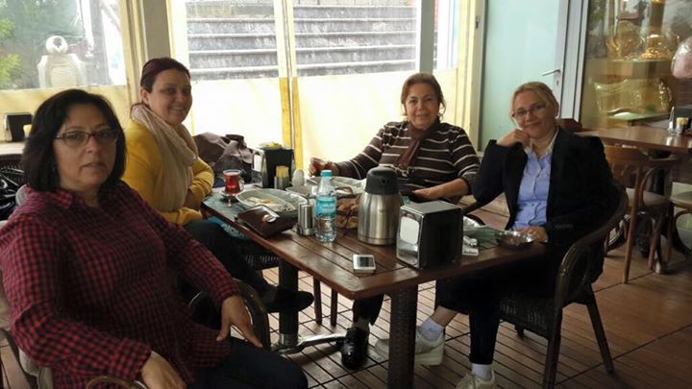
“What we have in common is our
strength,
where we differ is our
richness”
Notes:
As we have seen cultures have both common and distinct characteristics. As the brain tumour community what we have in common constitutes our strength and the areas we differ is our richness.

