Slide 1

Managing Volunteers
Jenny Baker
27th October 2015
Notes:
.

Slide 2
Outline
      Introduction
      About volunteering
        Global context
        Definitions
        Benefits
      A framework for managing volunteers
      Signposting to resources
      Discussion

Slide 3
Introduction
National Trust for England and Wales 1970-2005
Head of Volunteering & Community Involvement 1990-2005
Board member, Volunteering England 1993-2003
Government task groups on volunteering
Brain Tumour UK 2006-2013
Chief Executive
Healthwatch (England) 2013 -

Slide 4

Volunteering case study
Founded 1997 - national, home based, Trustee-led
Key purposes - support, research and awareness
1st CEO and administrator recruited 2003/4
2nd CEO in 2006 – funding critical!
National office opened 2008
Grew annual income to £2.5m by 2012
Building volunteering the critical success factor

Slide 5

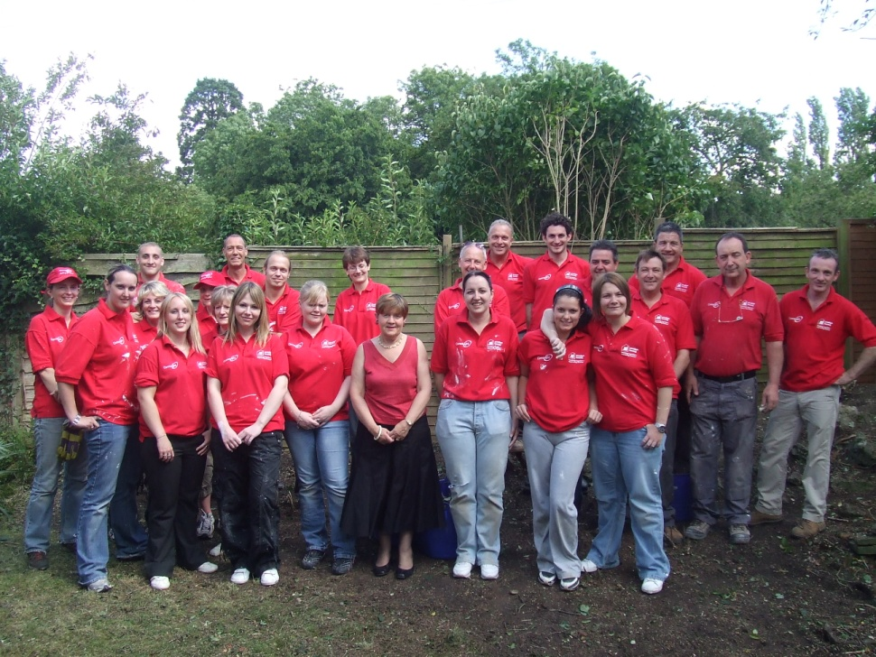
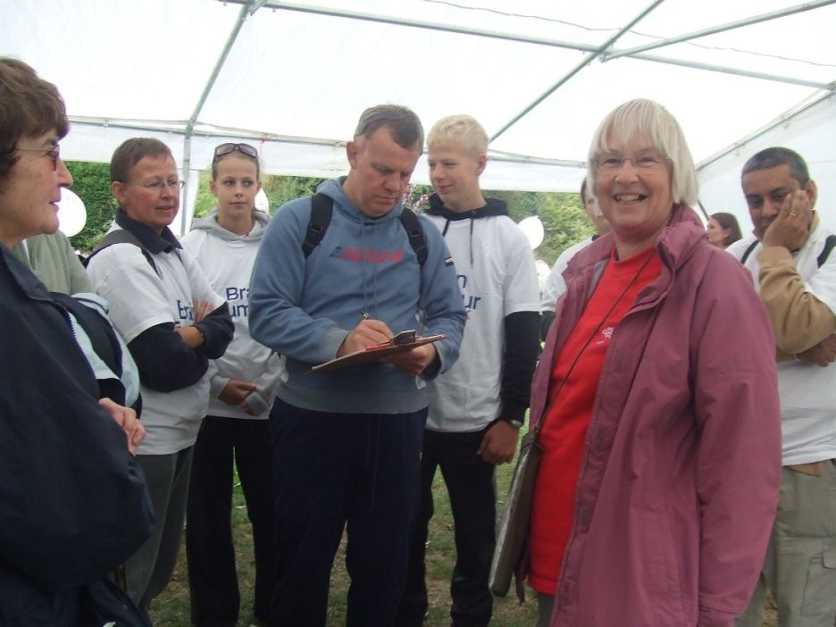
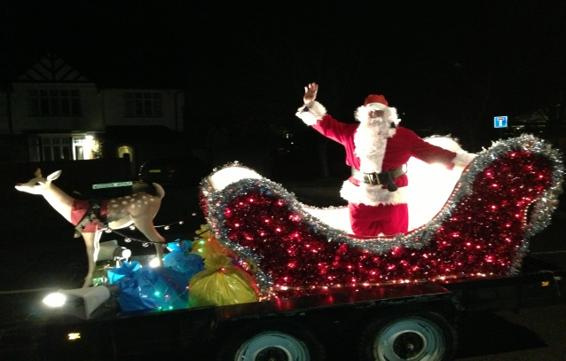
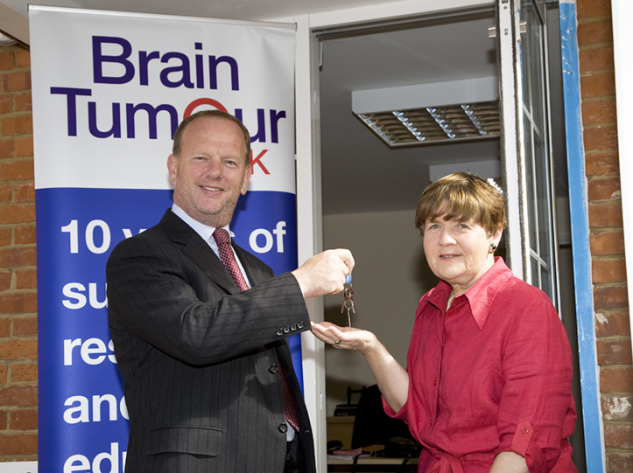
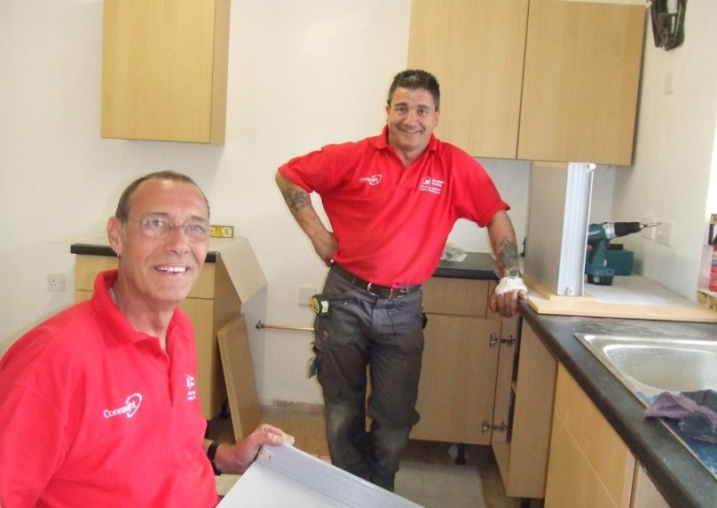
Volunteers at BTUK
Success through amazing support

Slide 6
Volunteers at BTUK )
Volunteers across all operational areas:
  100 volunteers
  30 roles – patient support groups, office, professional, advocates, advisors, ambassadors
  700+ fundraising volunteers
  100 tribute funds and teams
  President, patrons and trustees
  Dedicated volunteer co-ordinator

Slide 7



Slide 8
Global context
‘The world is hugged by the faithful arms of volunteers’
  Terri Guillemets (American writer)

Slide 9
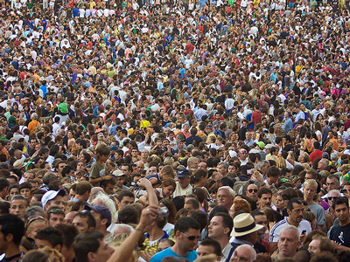
Notes:
Voluntary action by which people freely unite in shared endeavours towards a common purpose is a feature in almost every society across the world. Although the terms which define volunteering may vary in different languages and cultures, the values driving it are common and universal.

Slide 10




Notes:
Every day millions of people from all ages, backgrounds, ethnicities and faiths across the world, step forward to tackle problems, human needs and gaps across their local communities and/ or their shared communities of interest.
The brain tumour community is no exception. All organisations attending the IBTA Summit share a common heritage. All were founded by passionate, caring volunteers wanting to make a difference for brain tumour patients today and in the future. Our groups share a common language too. We speak about ‘the journeys of brain tumour patients’ at different stages of their care and treatments. Likewise each group at the Summit is at different stages of their organisation’s journey. Some are recently founded and wholly volunteer - led, while others have evolved over time into multi-million dollar ‘professionally led’ organisations with a CEO and 40+ staff managing and supporting hundreds of volunteers and fundraisers

Slide 11
Global context
Scale
Gallop World Poll - 16% of adults worldwide volunteered
Estimated 92-94 million adults volunteer in the EU
% of GDP in developed countries = 2.7%
% of GDP in developing and transition countries = 0.7%

Slide 12
Definition – volunteering
Volunteering:
gifts of time freely given
benefits the organisation, community and volunteer
a way for citizens to participate in community activities
a vehicle for individuals to address human, social and environmental needs
respects the rights, dignity and culture of others
promotes human rights, equality and diversity

Slide 13
Benefits of volunteering
For individuals:
Practical engagement in a special cause
A coping mechanism when facing personal challenge
Health, wellbeing, quality of life
Increased knowledge and understanding of cause - related issues
Can gain new skills and qualifications - a route to employment?
Applies lifetime skills and experience

Slide 14
Framework for managing volunteers
Meaning well is not enough
Beware of saying ‘yes’ automatically
Develop your volunteering plan and policies
Budget for volunteer involvement/management
Adopt good practice principles

Slide 15
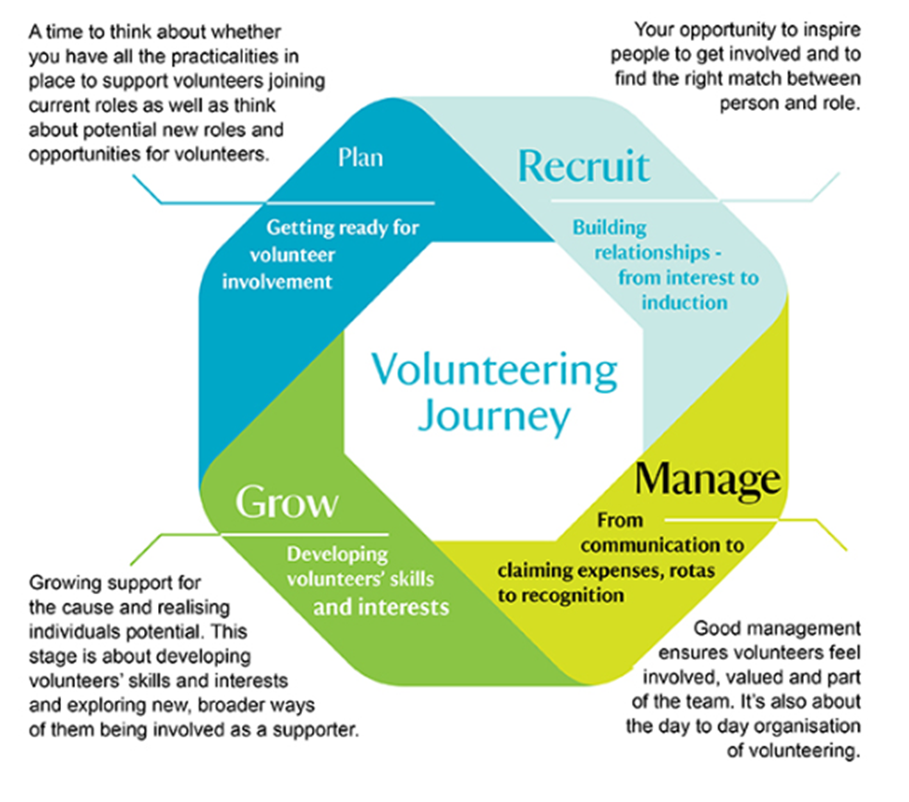

Slide 16
Resources
International Association of Volunteer Effort (IAVE): www.iave.org
European Volunteer Centre: www.cev.be
UN Volunteers: www.volunteeractioncounts.org/en International Volunteers Day (IVD): 5th December)
Centre for Volunteering Australia www.volunteering.com.au/working_with volunteers
National Council for Voluntary Organisations England www.ncvo-vol.org.uk
Welsh Council for Voluntary Action: www: www.wcva.org.uk/volunteering/working-with-volunteers
Energize, Inc – International training, consulting firm specialising in volunteerism www.energizeinc.com/

Slide 17

Greater collaboration, greater knowledge, greater hope
www.theibta.org
jeniferacbaker@gmail.com

